Slide 1
2018/2019 Measles Outbreak
Devin Zimmerman
IBM Data science capstone

Slide 2
Introduction
Measles is a highly contagious viral disease and remains an important cause of death among young children globally, despite the availability of a safe and effective vaccine. Measles is transmitted via droplets from the nose, mouth or throat of infected persons. Symptoms include high fever, a runny nose, bloodshot eyes, and tiny white spots on the inside of the mouth. 9 out of 10 susceptible persons with close contact to a measles patient will develop measles. Measles virus can remain infectious in the air for up to two hours after an infected person leaves an area. While global measles deaths have decreased by 84 percent worldwide in recent years — measles is still common in many developing countries, particularly in parts of Africa and Asia. An estimated 7 million people were affected by measles in 2016. Routine measles vaccination for children, combined with mass immunization campaigns in countries with low routine coverage, are key public health strategies to reduce global measles deaths. The measles vaccine has been in use since the 1960s. It is safe, effective and inexpensive. WHO recommends immunization for all susceptible children and adults for whom measles vaccination is not contraindicated.

Slide 3
Measles in 2018/2019
From January 1 to August 15, 2019, 1, 203 individual cases of measles have been confirmed in 30 states. This is an increase of 21 cases from the previous week. This is the greatest number of cases reported in the U.S. since 1992 and since measles was declared eliminated in 2000. Most cases are among people who were not vaccinated

Slide 4
Data Acquisition and Cleaning
Most of the data sources were obtained through the Center for Disease Control (CDC) and World Health Organization (WHO) websites. The had multiple sources that tracked the amount of unvaccinated people that were affected by the outbreak, what ages they were, and what communities were affected
State public health department websites were used to track down specific zip codes of the communities affected as well as reasoning behind the outbreak i.e. Atlanta area was affected because of the high international travel.
The data was clean with extensive review of the excel sheets to find commodities and remove excess and unnecessary data elements for analysis

Slide 5
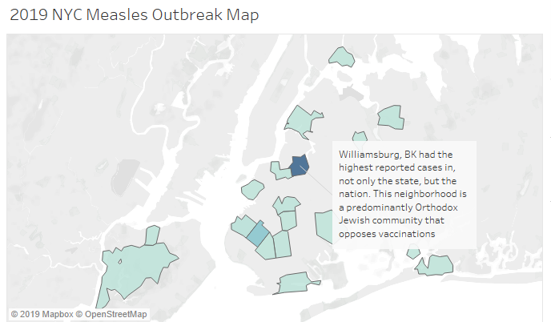
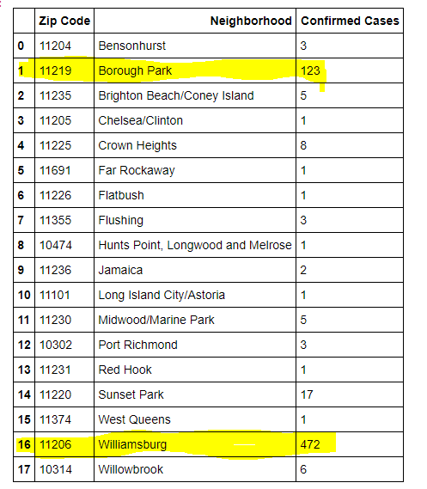
State Breakdown

Slide 6
State Breakdown
2019 NY State Breakdown: show in both the chart and map above, the measles outbreak affected New York state the most, with the highest amount of confirmed cases in the 2018-2019 period. I decided to breakdown the neighborhoods of New York City and analyze which neighborhood had the highest amount of cases and potentially investigate the community factors that could have contributed to this measles outbreak.
Among the national measles outbreak, New York had the highest reported cases, most residing in the New York City area. The Williamsburg neighborhood in Brooklyn had the highest confirmed cases at 472 cases. In the table above, many cases in New York state were unvaccinated children under the age of 17. This area is known for high skepticism related to vaccinations as well as religious views that prevent community members from obtaining the measles vaccine

Slide 7
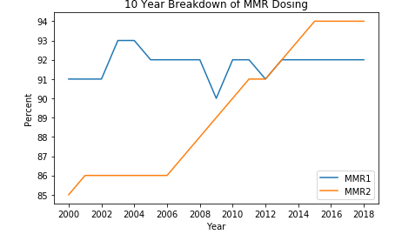
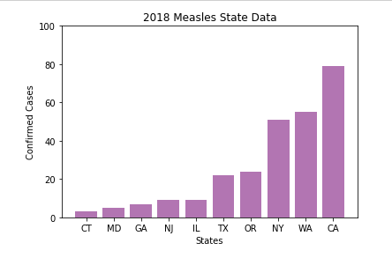
US National Breakdown

Slide 8
US National Breakdown
2018 Measles State Data: Reviewing the state data from each state’s Department of Health showed that the highest confirmed cases were in high transient and international traffic
Because of the high international traffic and proximity, transmission of measles spread rapidly across the nation. The highest reported cases were in other cities such as Los Angeles, Atlanta, and Seattle with increased international foot traffic.
Health organizations should continue to provide education to health care providers so they can disseminate the information about dosing and the effects of not vaccination and suffering from measles

Slide 9

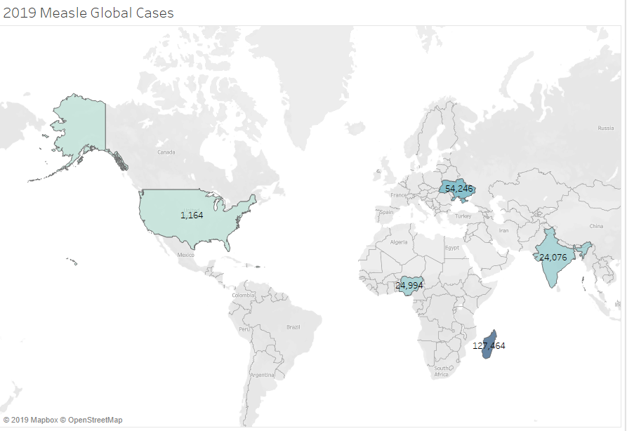
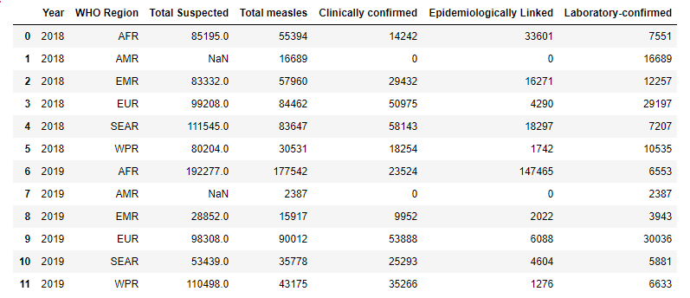
Global Impact

Slide 10
Global Impact
The 2019 Measles Global Cases Map shows the U.S. compared to countries with some of the highest confirmed cases. Each country has different reasons that have contributed to the spread of measles such as vaccine refusal, access issues to healthcare and vaccines, civil unrest and low awareness about the vaccination benefits. All these factors lead to low vaccination coverage for susceptible populations. The US has the highest amount of skepticism with vaccinations. As seen in the Global Measles Case Breakdown, all the confirmed cases were Laboratory Linked, meaning that the patient may or may not have known they had measles prior to seeking treatment

Slide 11
Conclusion
Public and global health departments can target and address communications issues to educate communities on the risk of measles.
Because of the limited data on how impactful education tools are on communities related to vaccinations, I would recommend a longitudinal study to monitor the implementation of new educational initiatives in high outbreak areas. It would also be beneficial to perform a deeper analysis of other developed nations affected by these outbreaks and find a common denominator to what is contributing to these outbreaks.
With this analysis and insights provided, we can hopefully combat issues related to vaccination and measles and once again, eliminate this disease.

Slide 12
References
https://www.cdc.gov/measles/transmission.html?CDC_AA_refVal=https%3A%2F%2Fwww.cdc.gov%2Fmeasles%2Fabout%2Ftransmission.html
https://www.cnn.com/2019/04/19/health/new-york-measles-outbreak-passover-williamsburg/index.html
https://www.sciencemag.org/news/2019/02/measles-cases-have-tripled-europe-fueled-ukrainian-outbreak
https://www.vox.com/2019/4/15/18311377/measles-outbreak-2019
https://www.cdc.gov/measles/cases-outbreaks.html

